Slide 1
Greenhouse Climate Control System
AVR Embedded Systems Final Project NTI Embedded System G1

Slide 2
Project Overview
An embedded application developed using the ATmega32 AVR Microcontroller. It continuously monitors environmental conditions and automatically controls actuators to maintain optimal growing conditions.

Slide 3


Core Objectives
Software Implementation
Hardware Integration
•
Apply Embedded C programming concepts.
•
Interface analog sensors using ADC.
•
Develop reusable peripheral drivers.
•
Control actuators through digital outputs.
•
Design an event-driven State Machine.
•
Build an automatic climate control system.
•
Practice modular software architecture.
•
Implement configurable operating parameters.

Slide 4

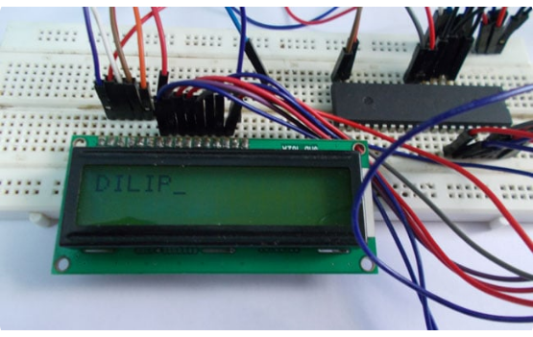
Key System Features
Monitoring: Temperature (LM35) and Soil Moisture sensing.
Automation: Automatic Irrigation, Fan, and Heater control.
Control Modes: Auto / Manual switching with Parameter Configuration.
User Interface: LCD 16x2 Display and Keypad Navigation.
Alerts: Warning Indicators via LEDs for abnormal conditions.

Slide 5
Hardware Components
Component | Purpose / Function
ATmega32 | Main Microcontroller Unit
LM35 & Soil Sensor | Temperature and Soil Moisture Monitoring
LCD 16x2 & Keypad | Display Information and User Interface Navigation
Relay Module | Pump / Fan / Heater Control
Water Pump, Fan, Heater | Irrigation, Cooling, and Heating Actuators
LEDs & Timer0 | Warning Indicators and Periodic Sampling

Slide 6






Functional Requirements
Automatic Mode
Manual Mode
Configuration Menu
System triggers water pump if moisture drops, turns on fan if temp is high, or heater if temp is low. Fan and heater are mutually exclusive.
Allows the user to manually control the Water Pump, Cooling Fan, and Heater. User can return to automatic mode at any time.
Admin/User can configure Max/Min Temperature, Soil Moisture Threshold, Sampling Period, and toggle Auto/Manual modes.

Slide 7
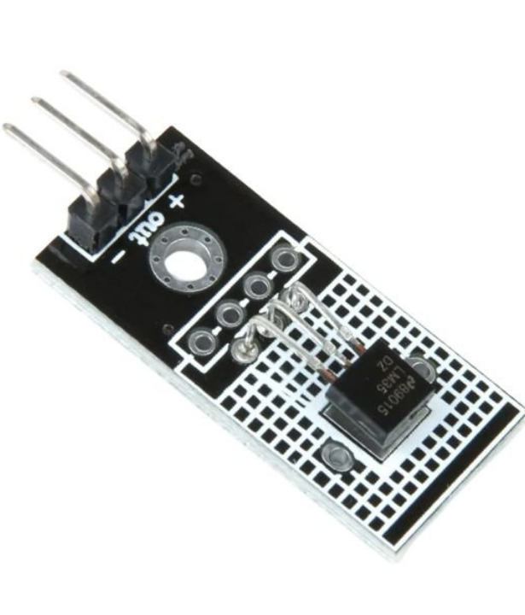
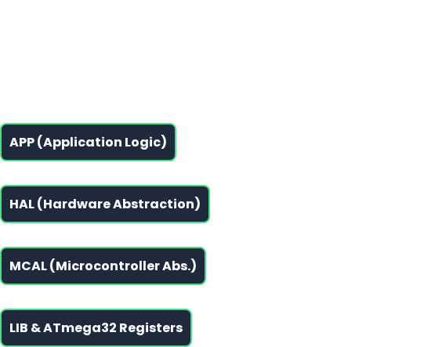
Software Layers
Layered Design Pattern
The software follows a strict Layered Architecture, promoting code reusability, modular design, and easy maintenance.

Slide 8


Hardware System Architecture
Input Interfaces
Output Interfaces
LM35 SensorAnalog Temp Input
LCD 16x2System Status Display
ATmega32
Soil MoistureAnalog Moisture Input
Relay ModuleControls Pump, Fan, Heater
Central Control Unit (ADC, GPIO, Timer0)
4x4 KeypadDigital User Input
Warning LEDsFault/Alert Indicators

Slide 9








System Execution Flow
System Initialization
Timer0 Interrupt: Read ADC (LM35 & Soil)
Is System in Auto Mode?
YES (Auto)
NO (Manual)
Compare Readings vs Thresholds
Read Keypad Inputs
Activate Appropriate Relays
Execute User Commands
(Pump, Fan, or Heater)
(Toggle specific actuator)
Update LCD Display & Wait

Slide 10
Non-Functional Requirements
Layered Architecture: Clean separation of concerns.
Easy Maintenance: Centralized control logic.
Modular Design: Self-contained software modules.
Scalable Software: Easy to add new sensors/actuators.
Code Reusability: Write once, deploy anywhere.
Portable Drivers: MCAL designed for easy porting.
Low RAM Usage: Optimized for ATmega32 constraints.
Hardware Abstraction: HAL protects APP from hardware specifics.
Fast Response Time: Event-driven state machine.
Efficient ADC Sampling: Timer0 based periodic sampling.

Slide 11
Questions?
Thank you for reviewing the Greenhouse Climate Control System details.

Slide 12


Image Sources
https://circuitdigest.com/sites/default/files/projectimage_mic/LCD-Interfacing-with-AVR.jpg
Source: circuitdigest.com
https://stemvolt.in/wp-content/uploads/2026/01/LM35D-Analog-Temperature-Sensor-Module-2.jpg
Source: stemvolt.in

